Slide 1
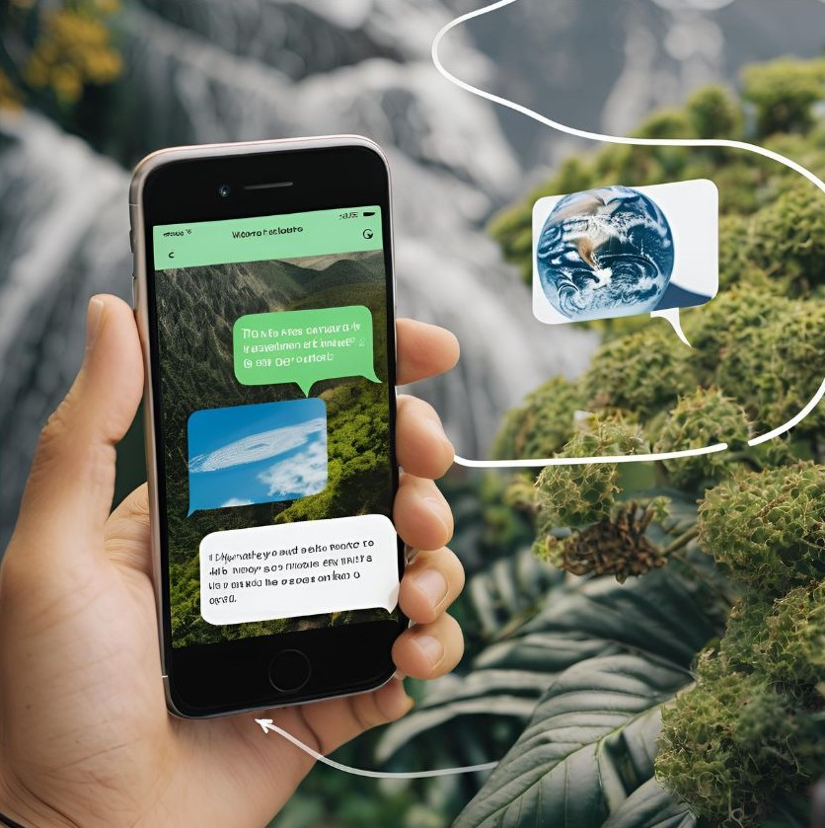

IBM SkillsBuild for Adult Learners – Artificial Intelligence
Artificial Intelligence Internship Program 2024
Final Project Presentation
Project Name
Unique ID
Team Name
College Name
:
:
: :
A chatbot to take action to combat climate change & impacts
IBM5013
Akatsuki
Mohan Babu University

Slide 2
TEAM MEMBERS:
1 . DHYANESWARAIAH JANGAM PARIDI - jpdhyanesh234@gmail.com (College ID- 22101A010431@mbu.asia)
2 . AJAYBABU KANTE - ramamohan600@gmail.com (College ID- 22101A010451@mbu.asia )
3 . PRANEETH PERASE - praneeth10025@gmail.com (College ID- 22101A010543@mbu.asia )
4 . ASHOK HARIJANA - harijanaashok8061@gmail.com (College ID- 22101A010422@mbu.asia)
5 . MEGHANA CHENIGUNTA - chaithugirlgaming@gmail.com (College ID- 22101A010382@mbu.asia )
6 . MAHESH KESULA - maheshmahii7508@gmail.com (College ID- 22101A010466@mbu.asia)
7 . NAVANEETH MANCHIKANTI - navaneethmbu@gmail.com (College ID- 22101A010496@mbu.asia)

Slide 3
INTRODUCTION:
Objective :
The primary objective of this to create a chatbot to give information about climate changes. The Aim of the model is to inform users & to make awareness about current climate variations, to give knowledge and tools necessary to make informed decisions and take meaningful action against climate change
Problem of the Project :
What is the Climate Change?
Climate Change refers to significant, long-term changes in the average weather patterns and conditions on Earth.
It encompasses a broad range of changes, including global warming, Melting Ice and Rising Sea Level, Impacts on Ecosystems and Biodiversity, Human Health and Socioeconomic Impacts

Slide 4
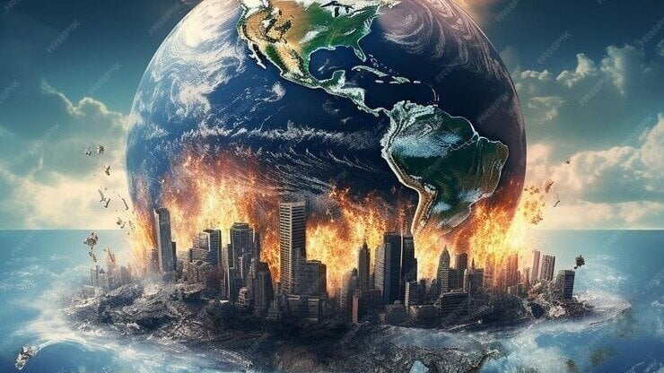
Causes :
Human Activities - Burning of Fossil Fuels, Deforestation, Industrial Processes, Agriculture, Urbanization.
Natural Factors - Solar Variability, Volcanic Activity, Ocean Currents, Natural Greenhouse Gas Emissions.
Feedback Mechanisms - Albedo Effect, Water Vapor, Permafrost Thawing.
Effects:
Environmental Impact - Rising Temperatures, Melting Ice Caps and Glaciers, Ocean Acidification.
Human Health - Heat-Related Illnesses, Spread of Diseases, Food and Water Security.
Social and Political Impact - Migration and Displacement, Conflict Over Resources, inequality.

Slide 5
Conceptualization of Chatbot :
Chatbots are emerging as powerful tools in the fight against climate change. By automating information-gathering, decision-making, and publicengagement, these AI-powered conversational agents can help individuals, communities, and governments tackle the complex challenges posed by a changing climate.
By combining sensor data and machine learning, chatbots can generate forecasts and simulations to inform climate-related decision-making.
Chatbot Persona :
By taking the above conceptualization into the mind, we have created a chatbot named “ ClimateCouch” .
Talking about the visual appearance, ClimateCouch is a virtual assistant which we can see on same web[ages .
Coming to the behaviour, this chatbot communities to the user by providing helpful information about the climate changes for the most common questions asked.
It communicates in basic English which is easily understandable.

Slide 6
Design Principles :
Natural language processing(NLP) - We used advanced NLP techniques to understand & process user inputs accurately .
Consistency – Our Chatbot maintain a consistent tone & style throughout the conversation to build trust & familiarity .
Accessibility – We ensure the Chatbot is accessible to any user which is public interaction .
Feedback – We collect user feedback regularly to understand their satisfaction & areas for improvement .
Development Tools :
To make our Chatbot , we used official & friendly website named “IBM Watsonx Assistant” . To check our Chatbot performance we used “wix.com” webpage the creating a sample webpage for our Chatbot . To get the images & logos we used AI tools like Gemini, Canva .etc .
Link of our Chatbot :
https://web-chat.global.assistant.watson.appdomain.cloud/preview.html?backgroundImageURL=https%3A%2F%2Fus-south.assistant.watson.cloud.ibm.com%2Fpublic%2Fimages%2Fupx-c7999f56-b52a-4369-abae-a480c37a425a%3A%3A1d063123-edcc-4b08-81ca-b3e1ab988dba&integrationID=f73706b5-b02f-4bd9-a004-a977d16e416e&region=us-south&serviceInstanceID=c7999f56-b52a-4369-abae-a480c37a425a

Slide 7
Use Cases :
Environmental Education & Awareness – Provides users with information on climate change , its effects & importance of Sustainable practices.
Carbon Foodprint Tracking – Help users to calculate & track their carbon foodprints based on their daily activities & provide suggestion for improvement.
Disaster preparedness & Response – Provide real time alerts & warning about extreme weather events & natural disasters.
Agricultural Support – Provide farmers with weather forecasts & climate data to help them make inform decisions.
Datasets used for Training :
Customer Support Dataset – Contains multi-turn dialogues from Ubuntu’s technical support, MultiWOZ & Taskmaster which includes dialogues from various customer service scenarios & technical support for Chatbot.
Socialmedia Datasets – Publicly available tweets & Reddit threads, useful for training Chatbot to handle informal and brief conversational styles.
Knowledge-Based Datasets – A Dataset for Question-Answering tasks, based on Wikipedia articles, useful for training Chatbots to provide informative responses.

Slide 8
Input Actions :
Action -1 Question about the Chatbot.
How can a user ask :
Tell me about this Chatbot?
What is the use of this Chatbot?
What is ClimateCouch?
Action -2 Question about the today’s weather.
How can a user ask :
What is the weather today?
I want to know about today’s climate?
Action -3 Question about climate change, and it’s detailed information
How can a user ask :
Tell me about climate change?
What are the causes of climate change?
What are the causes of climate change?
What is climate change?
How to control climate change?

Slide 9
Proposed solutions :
By creating out Chatbot, we proposed solution to the problem by providing suitable information about climate change, its causes, effects and steps to control them. And we provide awareness to the user who use over Chatbot.
Implementation Plan :
Our Chatbot is basic virtual assistant which shows on a web page, we have a plan to implement out Chatbot on every webpages which describes about climate. Then after, we want to implement it on mobile like Siri & Alexa. If we got chance in future, we want to create an app & device, which works like a robot.
Alignment with SDG :
At the end of every step, we provide link connecting to SDG page, so that every user can visit the page.

Slide 10
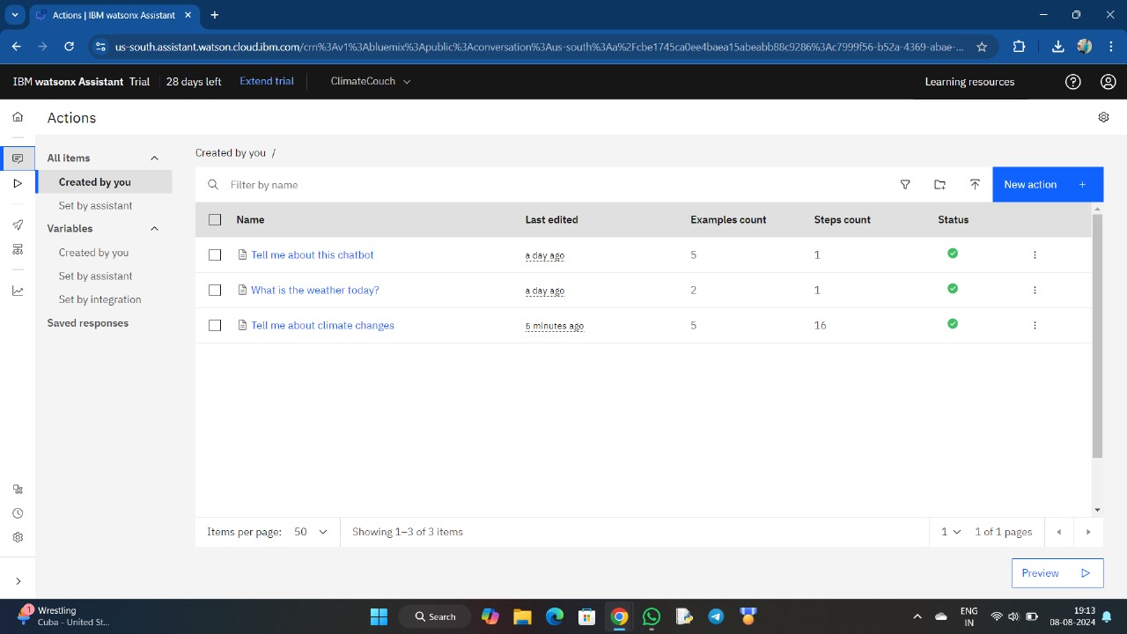
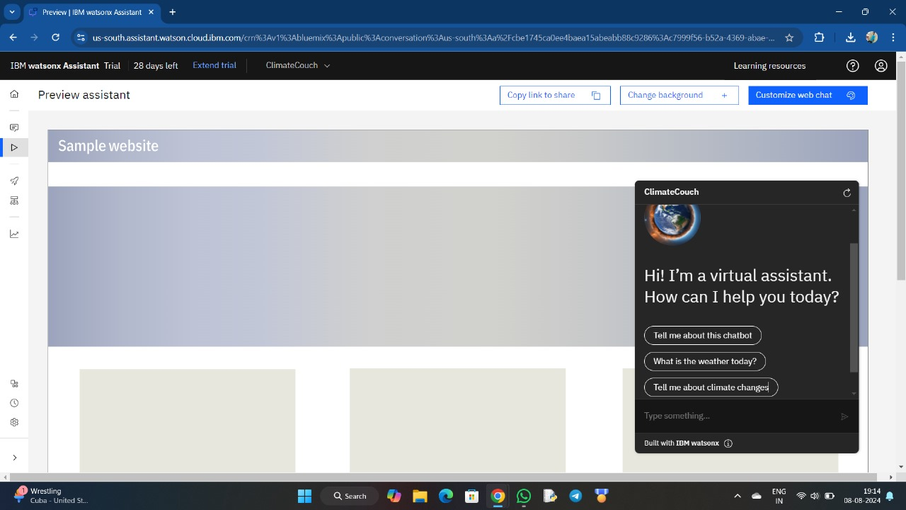
Input Screenshots :
Input Actions of our Chatbot.
How our Chatbot look like.

Slide 11
CONCLUSION :
Creating a chatbot for climate change action can significantly enhance public engagement and provide personalized, actionable guidance. This innovative tool fosters community mobilization and empowers users to make informed, impactful decisions. By leveraging technology, we can drive meaningful behavioral and systemic changes needed to combat climate change effectively.
IMPACT OF PROPOSED SOLUTIONS :
The Main expected outcomes on actions that be promoted for moto for the effects on climate changes Short-term Outcome like Increased awareness, improved engagement, personalized recommendations, Basic Q & A functionality. Long-Term Outcomes are like Scalability, Advanced functionalities, Collaborate with Other Organizations. Behavioral change metrics, Environmental impact metrices.
FUTURE WORK :
Chatbots have the potential to revolutionize how individuals, communities, and governments address climate change through data-driven, personalized, and scalable solutions. As chatbot technology advances, we can expect to seven more sophisticated applications for climate mitigation, adaptation, and public engagement. The successful integration of chatbots into climate action efforts will require interdisciplinary collaboration between technology, environmental, and social science experts.

Slide 12
REFERENCES :
Data Sources :
Some Datasets for take necessary actions on climate changes, they are
NASA's Climate Data Online.
National Oceanic and Atmospheric Administration (NOAA) Climate Data.
Climate Change Knowledge Portal.
Text Datasets for Climate Change Chatbot:
Climate Change Articles Dataset.
Climate Change Reddit Comments Dataset.
Machine Learning Datasets for Climate Change Chatbot:
Intent Identification Dataset.
Entity Recognition Dataset.
UCI Machine Learning Repository's Climate Change Dataset.
Kaggle's Climate Change Dataset
Tools & Software used :
To make our Chatbot , we used official & friendly website named “IBM Watsonx Assistant”. To check our Chatbot performance we used “wix.com ” webpage the creating a sample webpage for our Chatbot . To get the images & logos we used AI tools like Gemini, Canva .etc .

